Slide 1
SLALOM
BOSTON

Slide 2
Operationalize End-to-End
Cloud Analytics Solutions
Slava Kokaev Boston Business Intelligence User Group

Slide 3
Today’s Agenda
What is Azure Data Factory?
Key capabilities
Pipelines and activities
How to create one or more data pipelines
Linked services
Usage
Datasets
Brief introduction to event hubs
Scheduling and execution
Configure, Develop and Deploy Solution
Deployment
Performing transformations and computations

Slide 4
Key Takeaways
Focused information to help you prepare for the exam
Module where almost all the content is tied to one service – Azure Data Factory
Content can be used to learn, prepare and DEMO Data Factory for your customers
Hands-on is a MUST for this module

Slide 5


1
INTRODUCTION

Slide 6
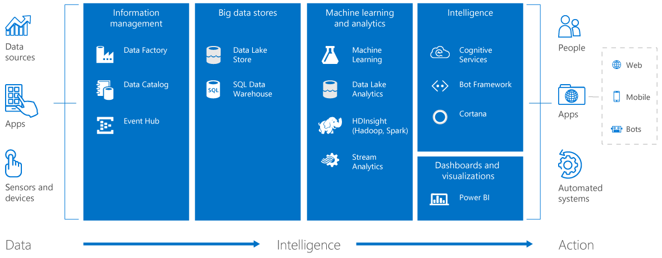
Cortana Intelligence Suite

Slide 7
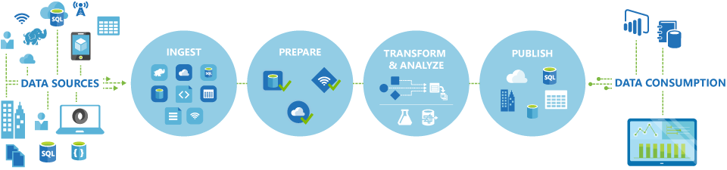
What is Azure Data Factory
Introduction to Azure Data Factory Service, a data integration service in the cloud
Data Factory is a cloud-based data integration service that orchestrates and automates the movement and transformation of data.
You can create data integration solutions using the Data Factory service that can ingest data from various data stores, transform/process the data, and publish the result data to the data stores.

Slide 8
Azure Data Factory
Enables enterprises
To ingest data from multiple on-premises and cloud sources easily, and gets your data where it needs to go. Prepare and partition your data as you ingest it, or apply pre-processing steps.
Allows you to create data pipelines
That move and transform data, and then run the pipelines on a specified schedule (hourly, daily, weekly, etc.).
Provides rich visualizations
To display the lineage and dependencies between your data pipelines, and monitor all your data pipelines from a single unified view.
Produce trusted data
Notes:
Data Factory is a globally deployed, fully managed data movement service in the cloud. It enables enterprises to ingest data from multiple on-premises and cloud sources easily, and gets your data where it needs to go. Prepare and partition your data as you ingest it, or apply pre-processing steps.
Data Factory allows enterprises to produce trusted data by easily composing, orchestrating, and monitoring diverse data, transformation and processing services at scale.
You can compose multiple data sources, on premises or in the cloud into highly available, fault tolerant, and streamlined data pipelines. You can process traditional relational data alongside data of different forms and velocities.
Data pipelines operate over the Hadoop ecosystem for transformations with Hive, Pig, and custom code, tying together your traditional relational data with features like automatic cluster management, retries for transient failures, configurable timeout policies, and alerting.
T: Lets look at the next service, Data Catalog
----
The Azure Data Factory service is a fully managed service for composing data storage, processing, and movement services into streamlined, scalable, and reliable data production pipelines. Developers can use Data Factory to transform semi-structured, unstructured and structured data from on-premises and cloud sources into trusted information. Developers build data-driven workflows (pipelines) that join, aggregate and transform data sourced from their on-premises, cloud-based and internet services, and set up complex data processing through simple JSON scripting. The Azure Data Factory service provides monitoring and management of these pipelines at a glance with a rich visual experience offered through the Azure Preview Portal. The information produced by pipelines can be easily consumed using BI and analytics tools, and other applications to reliably drive key business insights and decisions.

Slide 9

Data enrichment
Data Integration
What can We use Data Factory for?
Data Migration
Data Transformation
Data Cleansing
IoT Analytics
Use it to ingest data from multiple on-premises and cloud sources.
Schedule, orchestrate, and manage the data transformation and analysis process.
Transform raw data into finished or shaped data that's ready for consumption by BI tools or by your on-premises or cloud applications and services.
Manage your entire network of data pipelines at a glance to identify issues and take action

Slide 10
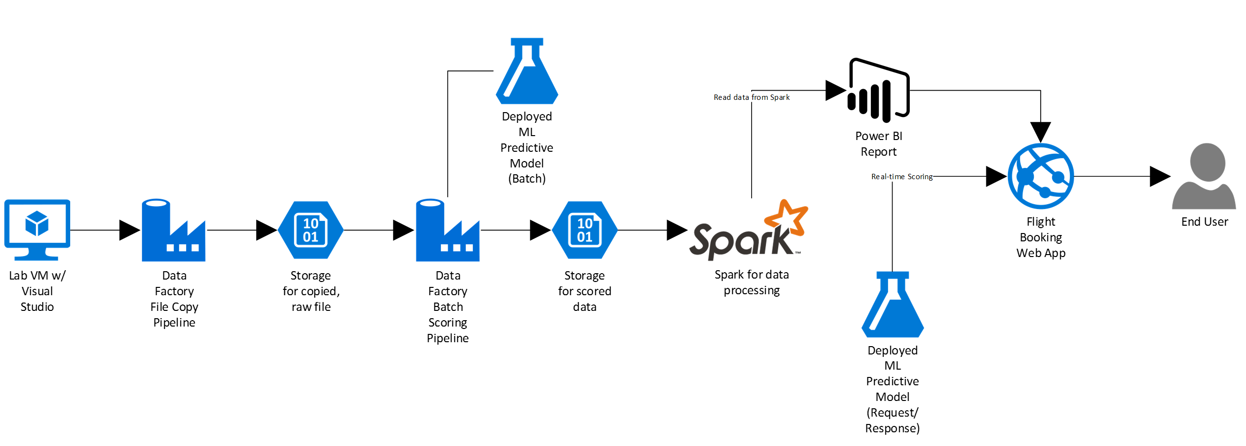

Slide 11

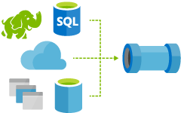
2
PIPELINES AND ACTIVITES

Slide 12
What is Pipeline
A pipeline is a logical grouping of activities. They are used to group activities into a unit that together perform a task.
To understand pipelines better, you need to understand an activity first.

Slide 13
What is Activity
Activities define the actions to perform on your data. For example, you may use a Copy activity to copy data from one data store to another data store. Similarly, you may use a Hive activity, which runs a Hive query on an Azure HDInsight cluster to transform or analyze your data. You may also choose to create a custom .NET activity to run your own code.

Slide 14
PIPELINE
Activity 1
Activity 2
Activity 3

Slide 15
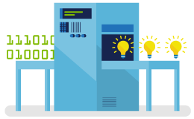
Activity Types
Data Factory supports two types of activities: and.
Data movement activities
Data transformation activities
Copy Activity in Data Factory copies data from a source data store to a sink data store. Data from any source can be written to any sink.
Data Transformation Activity transforms data to desired format and shape. Transformation activities that can be added to pipelines either individually or chained with another activity.

Slide 16
Supported Data Sources
Data Movement Activates
Azure
Databases
Azure Blob storage, Azure Data Lake Store
Azure SQL Database, Azure SQL Data Warehouse
Azure Table storage, Azure DocumentDB
Azure Search Index
SQL Server , Oracle , MySQL,
DB2, Teradata, PostgreSQL,
Sybase, Cassandra, MongoDB, Amazon Redshift
Files
Others
File System
HDFS
Amazon S3
FTP
Salesforce
Generic ODBC
Generic OData
Web Table (table from HTML)
GE Historian

Slide 17
Supported Activates
Data Transformation Activities
01
03
05
Hadoop Hive
Hadoop Pig
Hadoop MapReduce
Hadoop Streaming
Machine Learning
02
04

Slide 18
Supported Activates
Data Transformation Activites
06
08
10
Batch Execution
Update Resource
U-SQL
Stored Procedure
DotNet
07
09

Slide 19

3
LINKED SERVICES

Slide 20
Linked Services
Linked services define the information needed for Data Factory to connect to external resources (Examples: Azure Storage, on-premises SQL Server, Azure HDInsight).

Slide 21
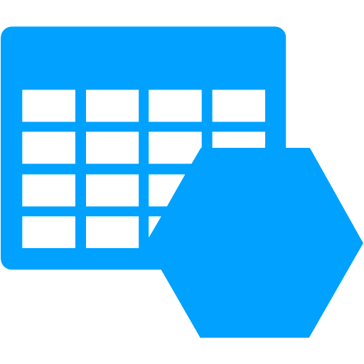

Linked Services
Linked services are used for two purposes in Data Factory:
To represent a data store
To represent a compute resource
including, but not limited to, an on-premises SQL Server, Oracle database, file share, or an Azure Blob Storage account.
that can host the execution of an activity. For example, the HDInsight Hive activity runs on an HDInsight Hadoop cluster.

Slide 22






Connecting To The Cloud Data Source
Linked Services
AB Linked Service
DLS Linked Service
ADF
DLS
AB

Slide 23

3
DATASETS

Slide 24
Datasets
Linked services link data stores to an Azure data factory. Datasets represent data structures with in the data stores. For example, an Azure Storage linked service provides connection information for Data Factory to connect to an Azure Storage account. An Azure Blob dataset specifies the blob container and folder in the Azure Blob Storage from which the pipeline should read the data. Similarly, an Azure SQL linked service provides connection information for an Azure SQL database and an Azure SQL dataset specifies the table that contains the data.

Slide 25
Scheduling & Execution

Slide 26
Data slice
A unit of data consumed and produced by an activity run.
Time series datasets and data slices
Continuous sequence of data points (E.g. sensor data and telemetry data)

Slide 27
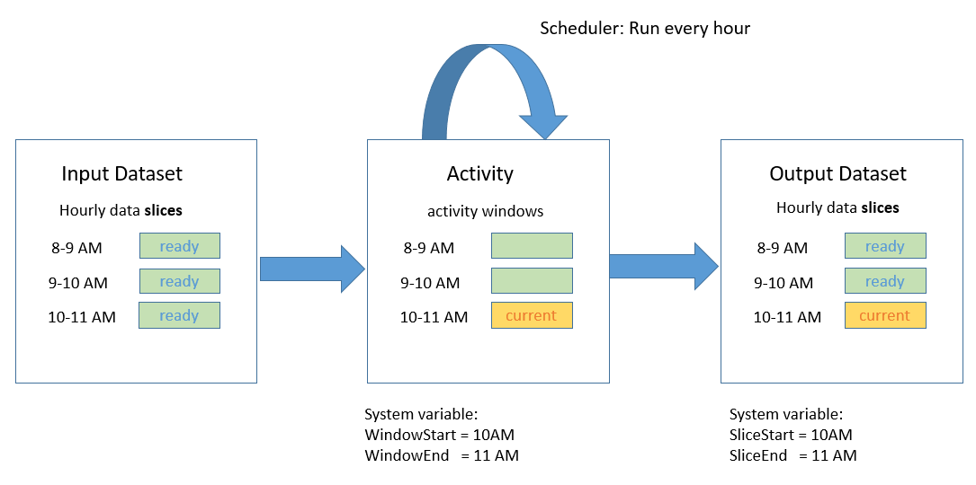
Scheduler
Example
:
"scheduler": {
"frequency": "Hour",
"interval": 1
}
Creates a Series of Tumbling Windows (Activity Windows)
Fixed-size series, non-overlapping and contiguous

Slide 28
Demo.
Imagination means nothing without doing.

Slide 29
Thank You!
Any Questions?

